Slide 1

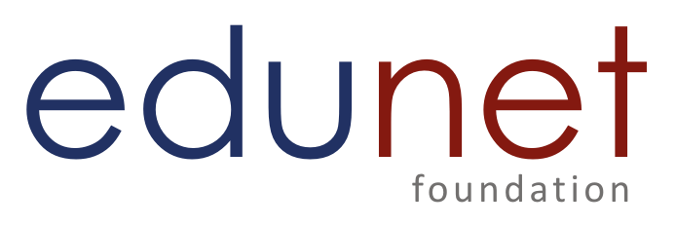
NEXT GEN EMPLOYABILITY PROGRAM
CREATING A FUTURE-READY WORKFORCE
Student Name :
Gurugubelli Anil
Student ID :
College Name :
STU6410961fd9d0f1678808607
GMR INSTITUTE OF TECHNOLOGY

Slide 2
CAPSTONE PROJECT SHOWCASE
Project Title
Project Management Tool
Abstract | Problem Statement | Project Overview | Proposed Solution | Technology Used | Modelling & Results | Conclusion | Q&A

Slide 3
Abstract
1
Full-Stack Project Management System – A robust project management tool built using the MERN stack (MongoDB, Express.js, React, Node.js) to efficiently handle projects and tasks.
2
User Authentication & Security – Secure JWT-based authentication ensures that only authorized users can access and manage their projects.
3
Project & Task Management – Users can create, update, and track projects and tasks, with seamless data storage in MongoDB.
4
Responsive & Scalable Architecture – The system is designed for scalability, flexibility, and performance, making it ideal for teams to collaborate efficiently.

Slide 4


Problem Statement
Project management is a critical aspect of any organization, yet many teams struggle with inefficient task tracking, poor collaboration, and lack of centralized project management tools. Existing solutions are often expensive, complex, or lack customization.
This project aims to develop a full-stack project management tool using the MERN stack that enables users to efficiently create, assign, and track projects and tasks with a secure authentication system. The solution provides a scalable, user-friendly, and cost-effective alternative for teams to manage their workflows effectively.

Slide 5

Project Overview
This project is a full-stack project management application built using the MERN stack (MongoDB, Express.js, React, Node.js) to streamline project and task management.
Key Features:
User Authentication – Secure login and registration using JWT authentication.
Project Management – Create, update, and delete projects with a structured database.
Task Tracking – Assign tasks to projects with status updates (To Do, In Progress, Done).
MongoDB Integration – Stores and retrieves data efficiently for scalability.
Responsive UI – A modern, interactive frontend built with React & CSS.
Purpose:
To provide an efficient and scalable tool for teams to collaborate, track tasks, and manage projects effectively in a user-friendly environment.

Slide 6
Proposed Solution
To address the challenges of inefficient project tracking, lack of collaboration, and scattered task management, we propose a scalable and user-friendly project management tool built with the MERN stack (MongoDB, Express.js, React, Node.js).
Key Aspects of the Solution:
Secure Authentication – Implements JWT-based authentication to protect user data.
Project & Task Management – Allows users to create, update, and track projects and tasks efficiently.
Role-Based Access – Ensures that only authorized users can manage specific projects.
Scalable & Efficient Database – Uses MongoDB to store project and task data for fast retrieval.
Modern, Responsive UI – Built with React & CSS, ensuring an intuitive user experience.

Slide 7
Technology used
Frontend (Client-Side)
React.js – For building a dynamic and interactive user interface.
React Router – For seamless navigation between pages.
Redux (if used) – For efficient state management.
CSS – For modern, responsive, and optimized UI styling.
Backend (Server-Side)
Node.js – For handling backend logic and API requests.
Express.js – For building RESTful APIs and server-side routing.
Database & Storage
MongoDB – A NoSQL database for storing users, projects, and tasks.
Mongoose – For object modeling and interacting with MongoDB.

Slide 8
Authentication & Security
JWT (JSON Web Token) – For secure user authentication.
bcrypt.js – For password hashing and security.
Development & Deployment Tools
Postman – For API testing.
Git & GitHub – For version control and code management.
Dotenv – For environment variable management.
Cors – For enabling cross-origin requests in APIs.

Slide 9
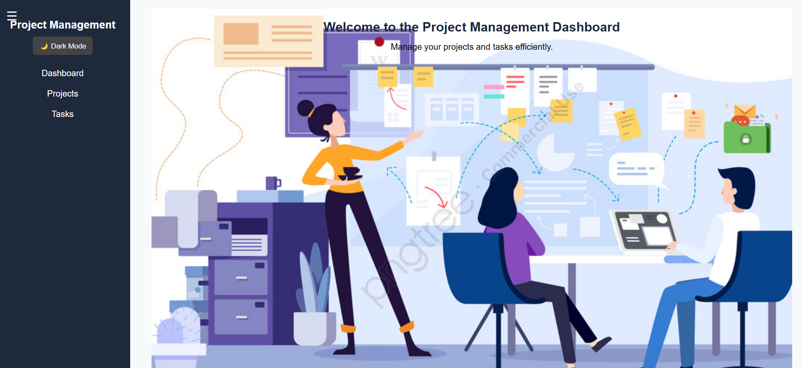
Modelling & Result

Slide 10
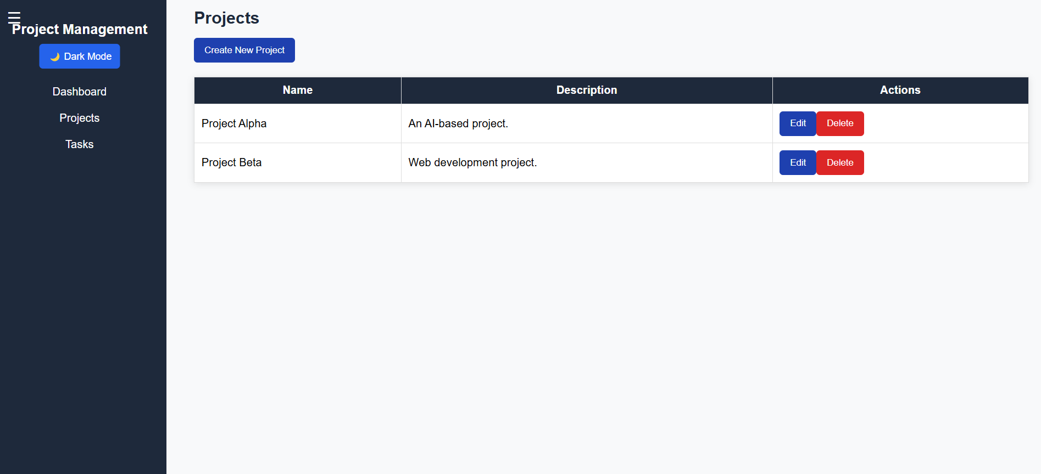
Modelling & Result

Slide 11
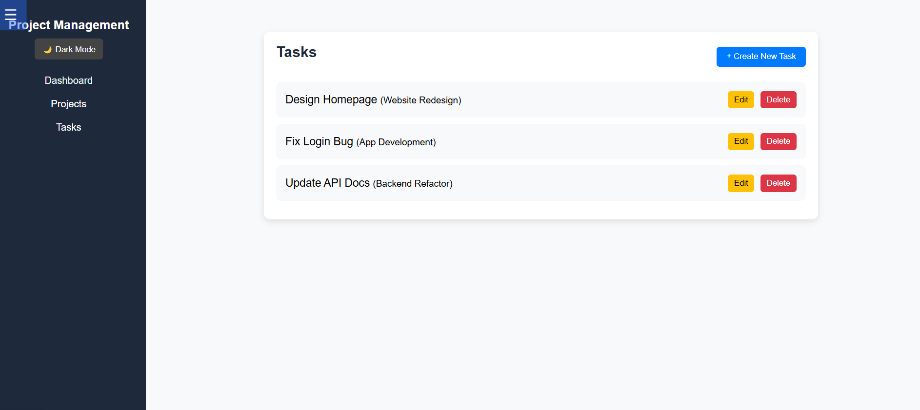
Modelling & Result

Slide 12

Conclusion
The MERN Stack Project Management Tool provides an efficient, scalable, and user-friendly solution for managing projects and tasks. By leveraging MongoDB, Express.js, React, and Node.js, this tool ensures secure authentication, seamless data handling, and a modern user interface for enhanced productivity.
With features like task tracking, project organization, and real-time collaboration, the system addresses common challenges in project management, offering a cost-effective and customizable alternative to existing tools.
This solution is ideal for teams and individuals looking for an intuitive platform to streamline their workflows, improve efficiency, and enhance collaboration in a structured environment.

Slide 13
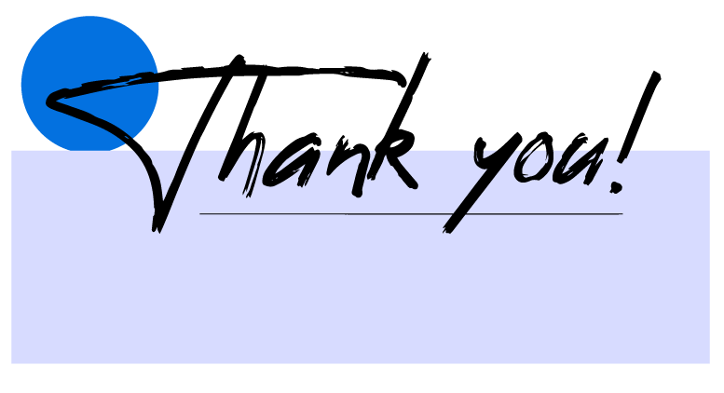
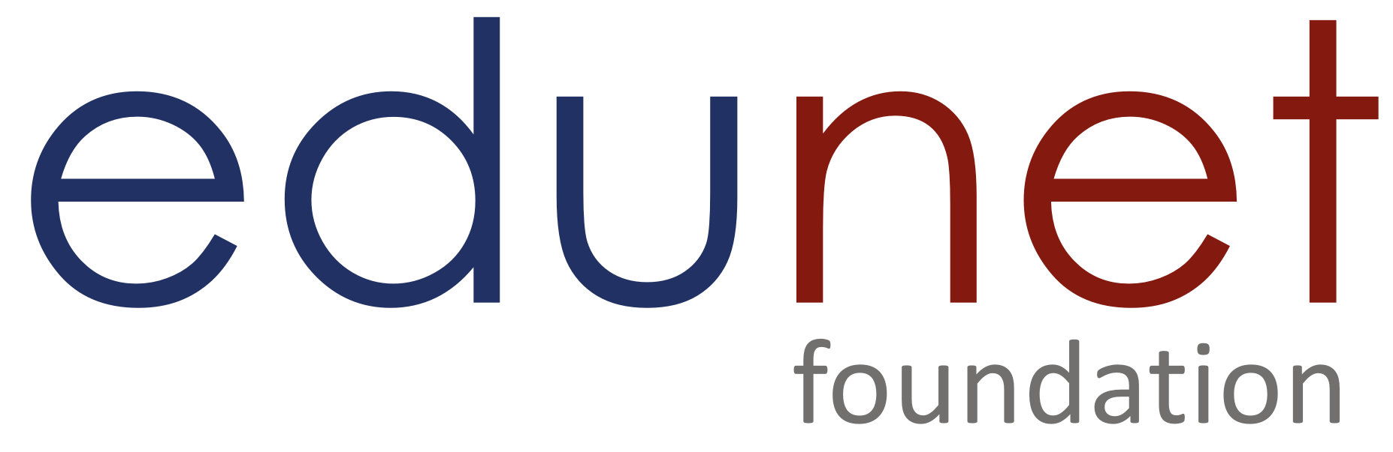
Notes:
Thank You !!

